Slide 1
Work, Kinetic Energy, and Potential Energy
Dr. Jacob Moore
Associate Professor of Engineering
Penn State Mont Alto

Slide 2
Work and Energy Methods
So far...
We have used kinematics to relate position, velocity, and acceleration.
And we have used the force mass and acceleration branch of kinetics, to relate forces to accelerations.
We are now going to discuss work and energy methods (another branch of kinetics), as an alternative to the force, mass, and acceleration method.

Slide 3
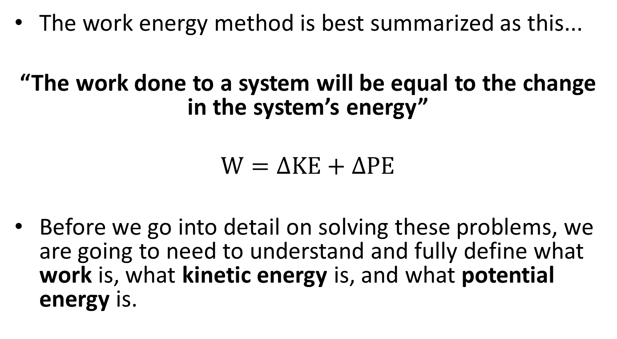
Work and Energy Method
The work energy method is best summarized as this...
“The work done to a system will be equal to the change in the system’s energy”
$$W=∆KE+∆PE$$
Before we go into detail on solving these problems, we are going to need to understand and fully define what work is, what kinetic energy is, and what potential energy is.

Slide 4
Work and Energy
Work – At its most basic level is a force exerted over a distance.
Work is not instantaneous; it is exerted between some starting and ending point.
Kinetic Energy – This is the energy a body possesses by virtue of being in motion
Energy is defined at an instant in time.
Potential Energy – This is the stored-up energy of an object that is lifted up high (gravitational) or the stored-up energy in a spring (elastic).
Again, energy is defined at an instant in time.

Slide 5
Work
The work done to a system will be equal a force times a distance.
$$F_{push}$$
d
$$F_{friction}$$
$W_{push}=F_{push}∗d$
$W_{friction}=−F_{friction}∗d$

Slide 6
Work
Only the component of the force in the direction of the motion does work on the system.
$$F_{push}$$
θ
d
$$F_{normal}$$
$W_{push}=F_{push}cos⁡(θ)∗d$
$$W_{normal}=0$$

Slide 7
Work
Sometimes we will encounter a force that changes as the body moves.
In cases such as this, the work done by the force will be the integral of the force function over the distance traveled.
$$W=\int_{x min}^{x max}{F(x) dx}$$
$$F$$
$$F\left(x\right)= …$$
$$x$$
x

Slide 8
Kinetic Energy
The kinetic energy of a body of a particle will be as follows
$$KE=\frac{1}{2}mv^{2}$$
In our conservation of energy equation, we use the change in kinetic energy, which assuming constant mass is…
$$∆KE=\frac{1}{2}m{v_{f}}^{2}−\frac{1}{2}m{v_{i}}^{2}$$
speed of object
mass of object

Slide 9
Kinetic Energy
While the direction of the force was important for work, the direction for the velocity for kinetic energy is not important.
Kinetic energy (and potential energy) are scalar values.
They do not have a direction
They cannot be broken down into components
Kinetic and potential energy cannot be negative (though changes can be negative)

Slide 10
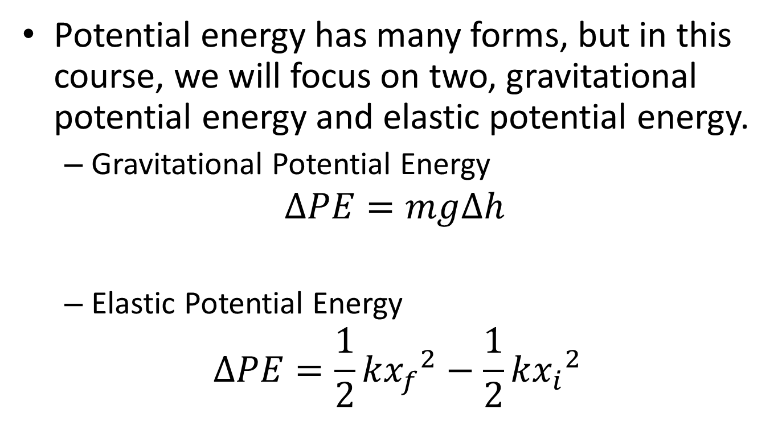
Potential Energy
Potential energy has many forms, but in this course, we will focus on two, gravitational potential energy and elastic potential energy.
Gravitational Potential Energy
$$∆PE=mg∆h$$
Elastic Potential Energy
$$∆PE=\frac{1}{2}k{x_{f}}^{2}−\frac{1}{2}k{x_{i}}^{2}$$
Change in height of the object
acceleration
of gravity
difference in length
from resting length
elastic spring
constant

Slide 11
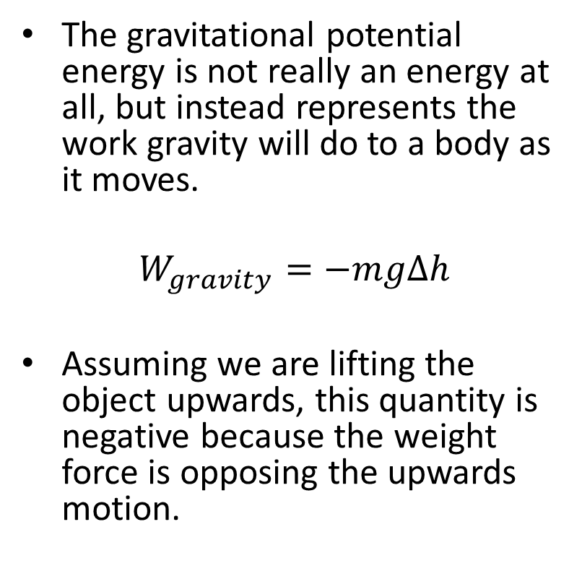
Gravitational Potential Energy
The gravitational potential energy is not really an energy at all, but instead represents the work gravity will do to a body as it moves.
$$W_{gravity}=−mgΔh$$
Assuming we are lifting the object upwards, this quantity is negative because the weight force is opposing the upwards motion.
$$F_{g}=mg$$
$$d = ∆h$$

Slide 12

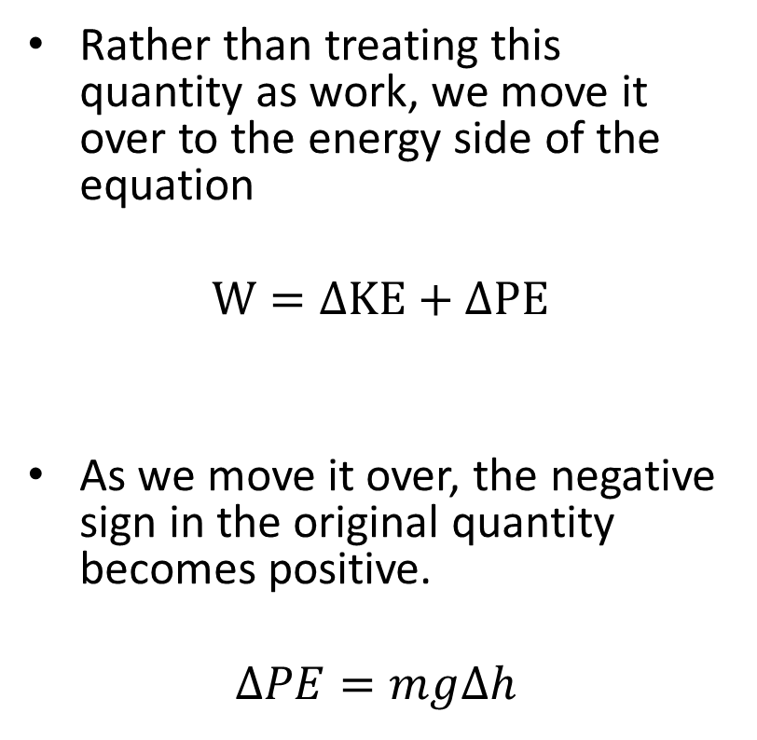

Gravitational Potential Energy
Rather than treating this quantity as work, we move it over to the energy side of the equation
$$W=∆KE+∆PE$$
As we move it over, the negative sign in the original quantity becomes positive.
$$∆PE=mg∆h$$
$$F_{g}=mg$$
$$d = ∆h$$

Slide 13
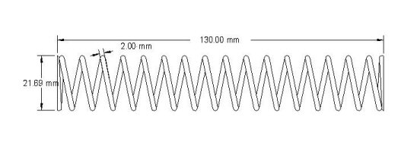

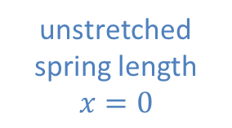


Linear Springs and Elastic Potential Energy
Imagine we have a spring attached to a mass and we compress that spring (going from point A to point B)
The magnitude of the force on the box will be equal to k*x at each point along this path.
k is the stiffness of the spring
x is the distance stretched from the resting position
Point B
Point A
unstretched spring length
$$x=0$$
$$F_{spring}$$
$$F_{spring}=kx$$
$$x$$

Slide 14
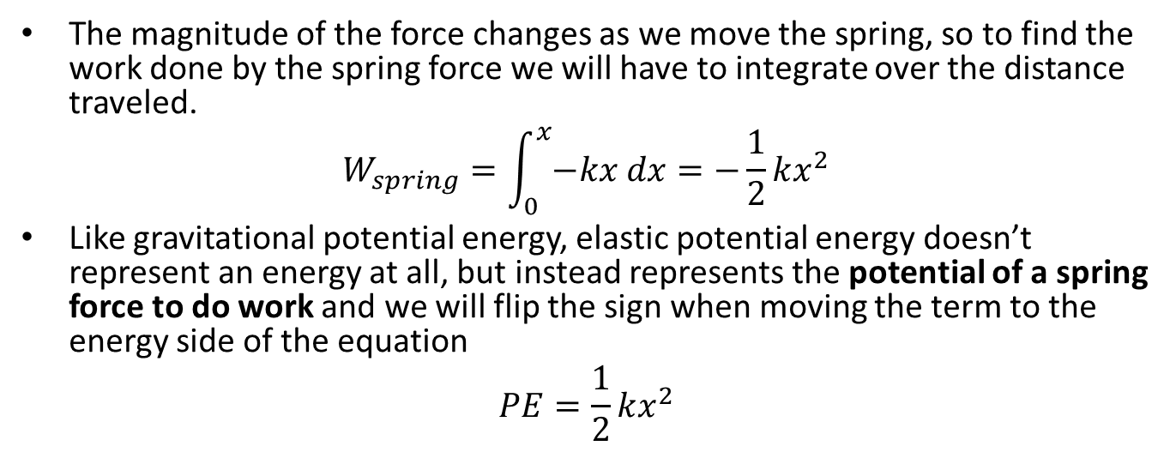
Linear Springs and Elastic Potential Energy
The magnitude of the force changes as we move the spring, so to find the work done by the spring force we will have to integrate over the distance traveled.
$$W_{spring}=\int_{0}^{x}{−kx dx}=−\frac{1}{2}kx^{2}$$
Like gravitational potential energy, elastic potential energy doesn’t represent an energy at all, but instead represents the potential of a spring force to do work and we will flip the sign when moving the term to the energy side of the equation
$$PE=\frac{1}{2}kx^{2}$$
Point B
Point A
unstretched spring length
$$x=0$$
$$F_{spring}$$
$$F_{spring}=kx$$
$$x$$

Slide 15
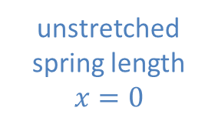

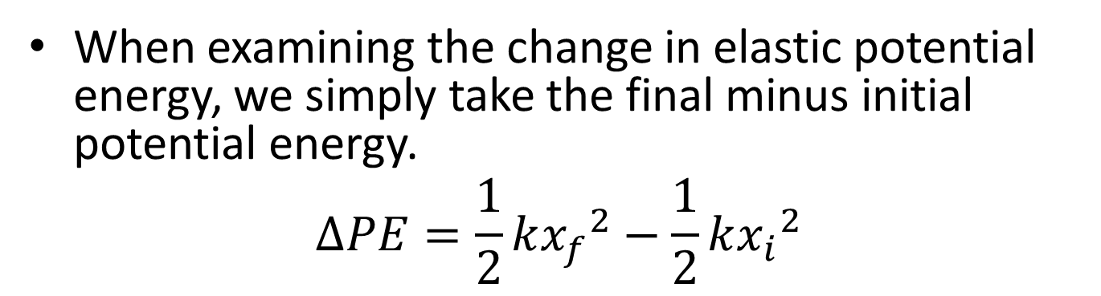


Linear Springs and Elastic Potential Energy
When examining the change in elastic potential energy, we simply take the final minus initial potential energy.
$$∆PE=\frac{1}{2}k{x_{f}}^{2}−\frac{1}{2}k{x_{i}}^{2}$$
unstretched spring length
$$x=0$$
$$F_{spring}=kx$$
$$x_{i}$$
$$F_{spring}$$
$$F_{spring}=kx$$
$$x_{f}$$

Slide 16
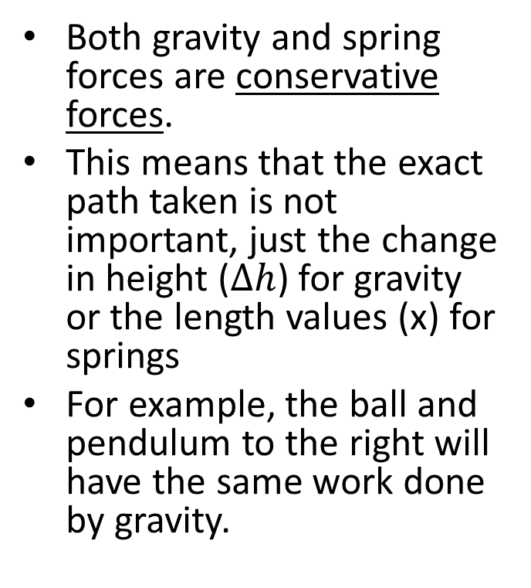
Path Independence and Potential Energy
Both gravity and spring forces are conservative forces.
This means that the exact path taken is not important, just the change in height ($∆h$) for gravity or the length values (x) for springs
For example, the ball and pendulum to the right will have the same work done by gravity.
$$F_{g}$$
$$F_{g}$$
$$∆h$$

Slide 17
Thanks for Watching
See other engineering mechanics videos and access the full tool at…

Slide 18
Work Worked Example
A 16 lb crate slides down a ramp as shown to the right. If the crate is released from a height of 10 ft
What is the work done by gravity?
What is the change in gravitational potential energy
10ft
60º

